Slide 1


Don Bosco Institute of Technology
Department of Electronics and Communication Engineering
Anti-Smuggling system for forest trees using IOT WSN
Group no:-26
Project Associates
Kokila S – 1DB20EC043
Lalithashree K – 1DB20EC044
Guided By
Mr. Kishor Kumar
Assistant Professor
Dept. of ECE, DBIT

Slide 2
CONTENTS
2
Abstract
Introduction
Literature survey
Problem Statement
Motivation
Objectives
Methodology
Software/Hardware Requirements
Schematic
Flowchart
Application
Advantages
Results
Conclusion
Future Scope
References

Slide 3
ABSTRACT
‘‘Digitalization of forest”, as this phrase itself suggests the sustainable implementation of cutting-edge technologies into forests for improving the current trends that are being used for forest environment monitoring, data acquisition, and analysis in the field of research and development.
Technologies that can be used effectively for achieving these objectives include the Internet of Things, Wireless Sensor Networks.
This work proposes the system called Anti-smuggling for forest tree that use for sensing, monitoring, used in applications such as forest fire incidents, illegal logging of trees, poaching.
This helps in reducing deforestation and maintains the ecological balance.

Slide 4
INTRODUCTION
During the last decades, the phrase ‘‘sustainability” has become very popular in the definition of utilizing energy resources.
Within the sense of development in the Global Environment and Development Commission Report, the most general term and interpretation is known as sustainability. In sustainable forest operations (SFO) is a holistic approach and strategy in an attempt to improve current and future problems effectively.
Deforestation and forest degradation continue at exponential levels, which greatly lead to the continued depletion of biodiversity.

Slide 5
LITERATURE SURVEY
Sl.No | Ist Author, Title, Publication Year | Highlights | Limitations
1. | Mr.V.Narasimman Asst. Prof,.M, Anandha kumar.C, Krishnan. T "Design of a WSN node for forest trees against poaching", 978-93-87793-11-8, ICAETS-2018. | This project proposes a based anti-poaching system employing WSN microcontroller technology, and MEMS accelerometer. | Power consumption Limited Coverage Environmental factors Cost Reliability Security
2. | Santhosh Hebbar, Praveenraj Pattar, Rajeshwari Madli, Varaprasad Golla. "Sandalwood Tree Protection Using Bluetooth Version 4.0", Conference on Computing and Network Communications, 978-1-4673-7309- 8/15/2015 IEEE | The main objective here is to build a protection system using Bluetooth 4.0 and GSM to alert the concerned authorities in case of sandalwood robbery | Range limitation Battery life Interface Security Compatibility Cost

Slide 6
LITERATURE SURVEY
Sl.No | Ist Author, Title, Publication Year | Highlights | Limitations
3. | Prof. Mhaske D.A., Bhabad Vishnu S. PathareSagar A. "Anti- smuggling System for Treesin Forest using Flex Sensor with GSM & Zigbee Network", International Journal of Advanced Research in Computer and Communication. Engineering Vol. 5, Issue 4, April 2016. | A low power MSP430 microcontroller along with RF modules is being used. WSN is widely cast-off technology in monitoring and controlling the remote applications. | Complexity Cost Power consumption Range limitations Interference Compatibility
4. | Mohan Sai.S.Naresh K, RajKumar.S, Mohan Sai Ganesh, Loksai, Abhinav "An Infrared Image detecting System model to monitor human with weapon for controlling smuggling of Sandalwood Trees". International Conference on Inventive Communication and Computational Technologies | The application of machine learning to prevent smuggling of trees. Inception-V3 model is the pre-trained convolutional neural network used in the proposed system for training the system | False positives Cost Maintenance Privacy concerns Legal considerations
Notes:
ECE

Slide 7
LITERATURE SURVEY
Sl.No | Ist Author, Title, Publication Year | Highlights | Limitations
5. | Prof. P. G. Salunkhe, Poonam U. Chaudhari "Design of WSN Node for Protection of Forest Trees Against Poaching Based MSP430", International Conference on Advances in Communication and Computing Technology (ICACCT),978-1- 5386-0926-2/18/©2018 IEEE. | The suggested system over here consists of tree unit and main server unit. Each tree has a micro controller, Flex sensor, Accelerometer, temperature sensor, Zigbee and GSM module. The cutting down of tree is sensed by flex sensor and accelerometer | GSM link breakage

Slide 8
Problem Statement
Protecting the forest and valuable medicine plants are very essential from smuggling and fire catch, currently there is no such system to detect and alarm above mentioned problems. Therefore, using the sensor and wireless technology we can build effective and efficient system to avoid the deforestation and maintain ecological balance which would play major role in reducing global warming

Slide 9
MOTIVATION
Forest fire is one of the causes of deforestation, as hundreds of trees are devastated each year because of forest fires in different parts of the world.
The warmest summers and milder winters are the reason for this. Whether it is caused by human beings or by accident, fires lead to a major loss of forest cover
Climate imbalance rise in global warming & greenhouse emissions, soil erosion, floods occurrence, wildlife extinction & habitat loss, food insecurity, and loss of biodiversity are the effects of deforestation. Motivated by the prior remarks we introduce the Intelligent systems for sensing, monitoring, and methods for analysis to be used in applications such as forest fire incidents, illegal logging of trees, poaching.

Slide 10
OBJECTIVES
To detect any movement or displacement of the tree, which can indicate that it is being cut down or transported.
To detect any unauthorized activities such as drilling, digging, or blasting near the trees.
It helps in taking immediate action to prevent the spread of fire and save the trees from any potential damage.
To detect any smoke near the trees
To detect any movement or presence of animals or humans near the trees. This can help in preventing illegal activities such as poaching, hunting, or deforestation.

Slide 11
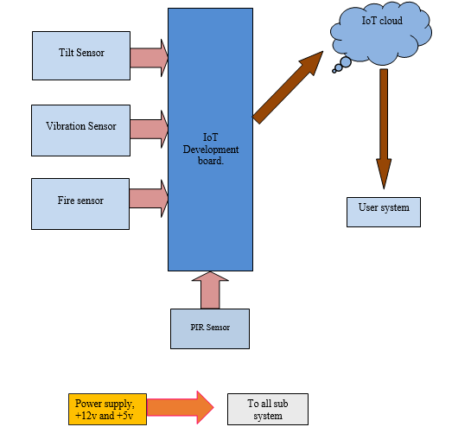
METHODOLOGY

Slide 12
Software/Hardware Requirements
Hardware
IoT Development Board ESP8266(Node MCU)
Tilt sensor
Vibration sensor
Fire sensor
PIR sensor
Power supply
Software
Programming language: Embedded C\C++
Software Tool: Arduino IDE 1.8.19

Slide 13
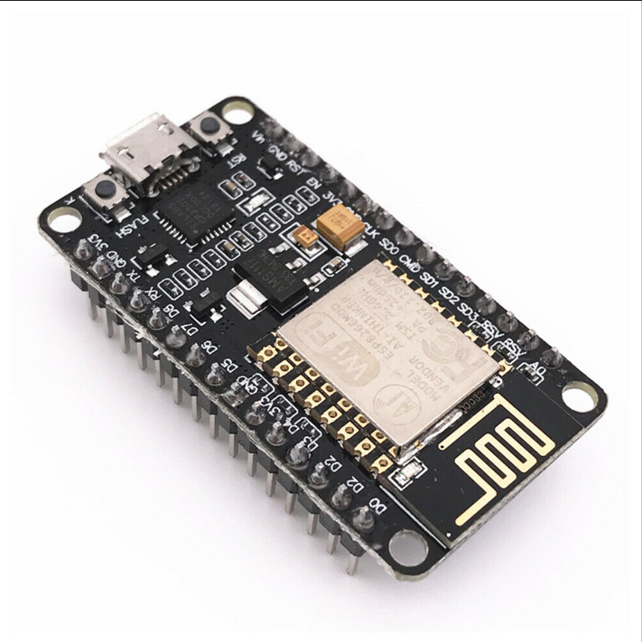
COMPONENTS
Fig 1:ESP8266
NodeMCUThe NodeMCU (Node MicroController Unit) is an open-source software and hardware development environment built around an inexpensive System-on-a-Chip (SoC) called the ESP8266.
The ESP8266, designed and manufactured by Espressif Systems, contains the crucial elements of a computer: CPU, RAM, networking (WiFi), and even a modern operating system and SDK. That makes it an excellent choice for Internet of Things (IoT) projects of all kinds.

Slide 14
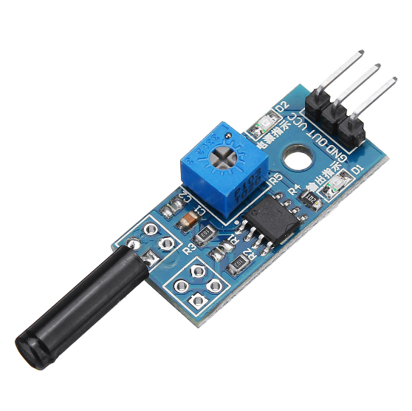
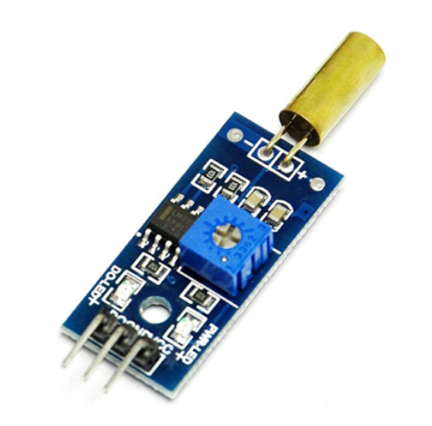
A vibration sensor is a device that measures the amount and frequency of vibration in a given system, machine, or piece of equipment.Those measurements can be used to detect imbalances or other issues in the asset and predict future breakdowns.
Fig 2:Vibration Sensor
Tilt sensors, also known as inclinometers or tilt switches, are electronic devices used to detect changes in the orientation or tilt of an object with respect to the Earth's gravitational field. They are designed to measure the angle of inclination or tilt relative to a reference plane, such as horizontal or vertical.
Fig 3:Tilt Sensor

Slide 15
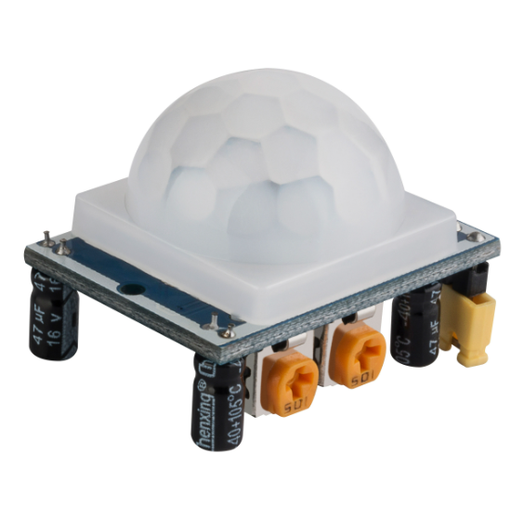
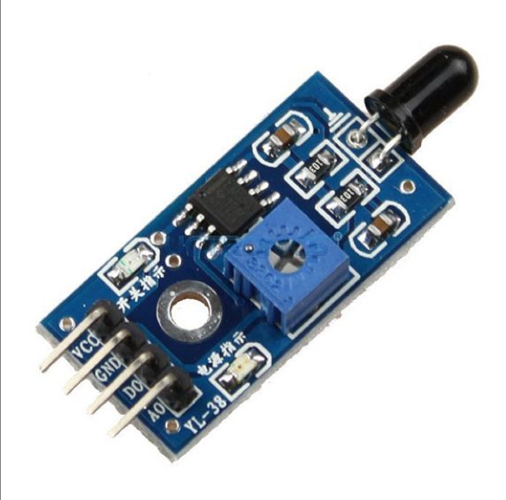
A PIR sensor, also known as a Passive Infrared sensor, is a type of electronic sensor that detects infrared (IR) radiation emitted by living beings and objects within its detection range.
PIR sensors are commonly used for motion detection in various applications, such as security systems, automatic lighting systems, and occupancy sensing.
Fig 4:PIR Sensor
Fire sensors, also known as smoke detectors or fire alarms, are devices designed to detect the presence of fire or smoke in order to provide an early warning and alert individuals to potential fire hazards. These sensors play a crucial role in fire safety systems and are widely used in homes, businesses, and public buildings.
Fig 5:Fire Sensor

Slide 16
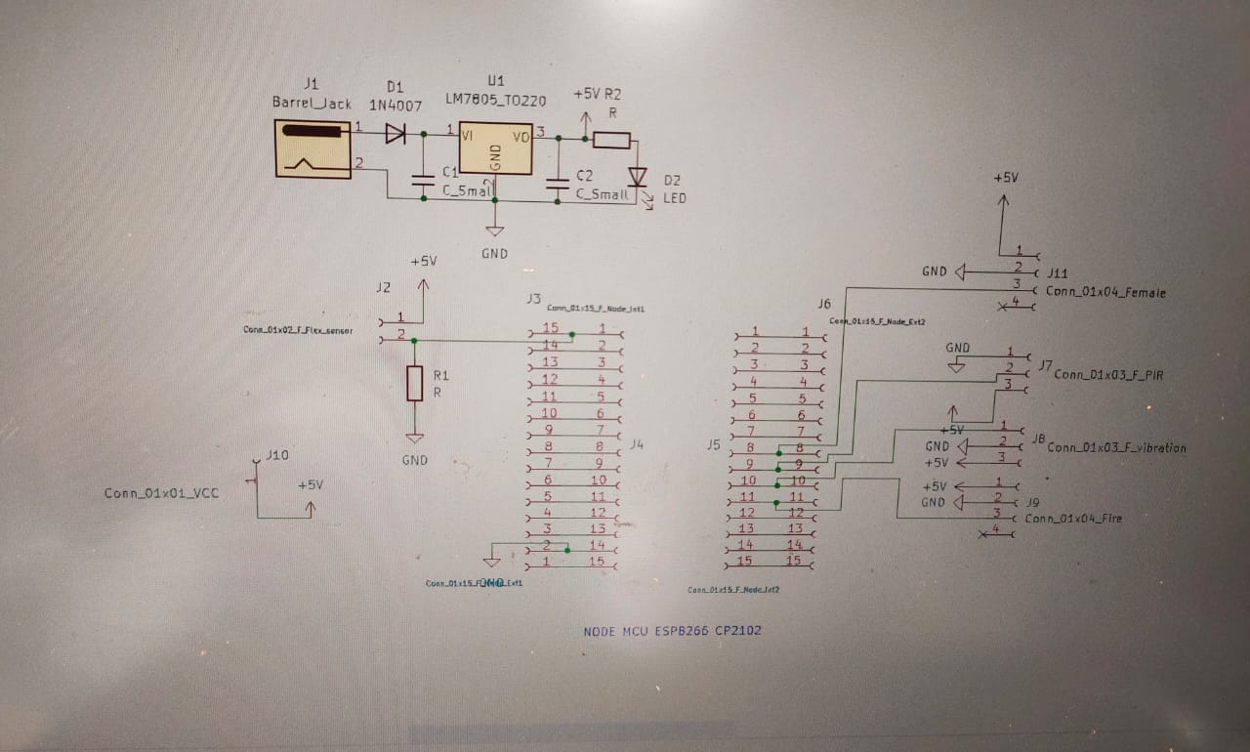
Schematic

Slide 17
Flow chart
START
Sensor inputs
Tilt sensor
Fire sensor
PIR sensor
Vibration sensor
No
No
No
No
Yes
Yes
Yes
A

Slide 18
A
Obtain the status
Updated data
STOP

Slide 19
Applications
Forest fire detection and analysis and prediction.
Rain fall analysis can be achieved.
It can be used in all parks to provide security.
This concept can be used to save trees such as Sandalwood, Red Sandalwood, Medicinal trees etc.
This can be useful in detecting any damage caused by natural disasters such as earthquakes, landslides, or storms.

Slide 20
Advantages
Man power is reduced to a great extent. This is because; the forest officials can supervise via the control room, without the need of going to each and every area of the forest checking.
Global warming is also reduced to a great extent.
The natural habitat of the wild animals is preserved this in turn helps in reducing Thereby, the ecological balance is maintained.
Deforestation can be reduced
Helps in detecting any illegal activities such as cutting down trees or smuggling

Slide 21
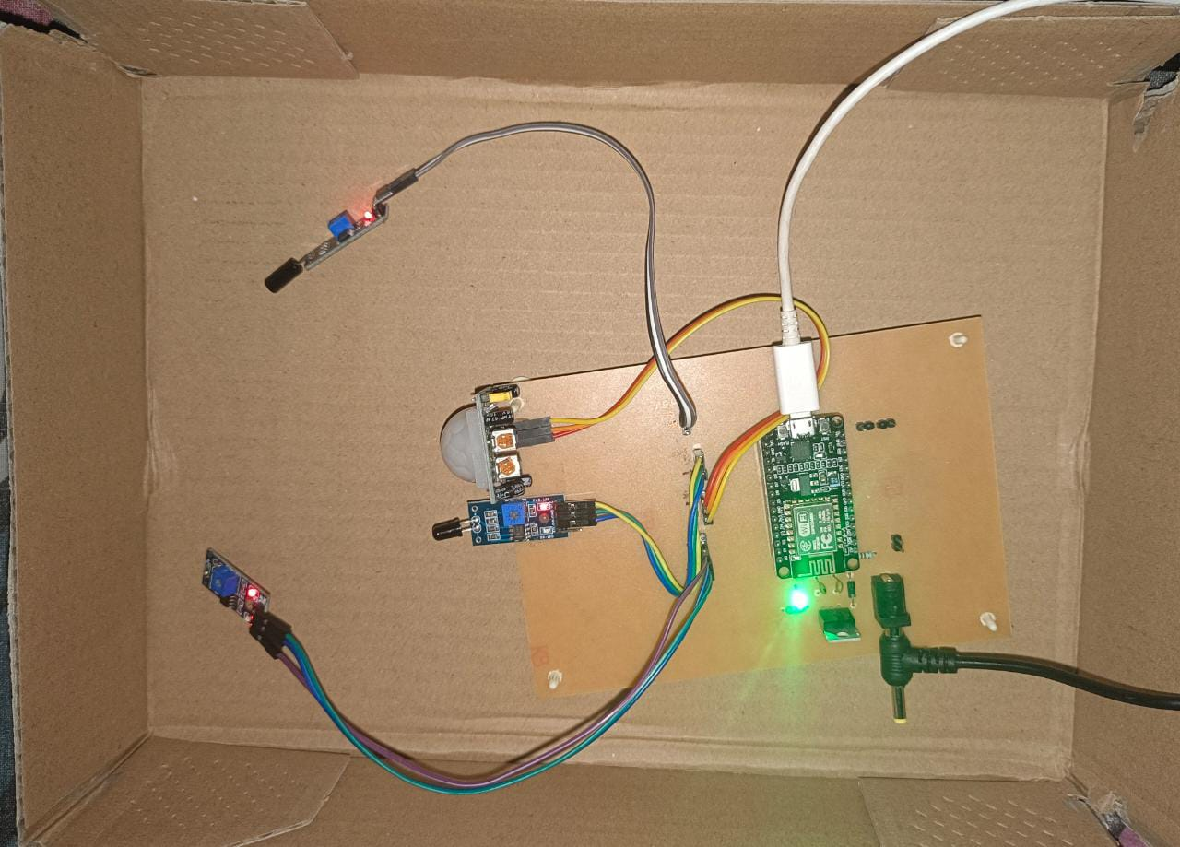
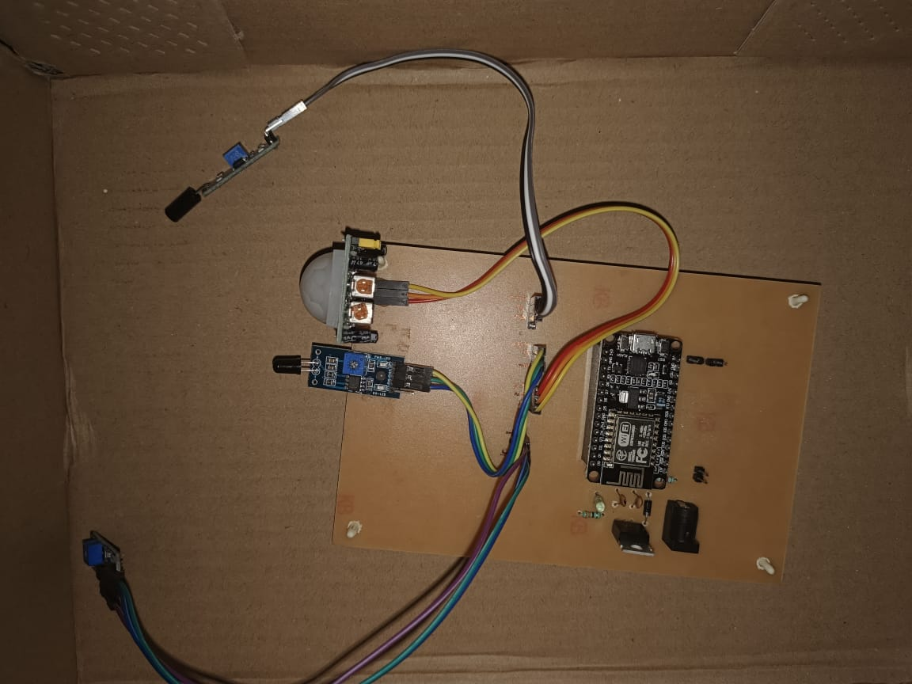
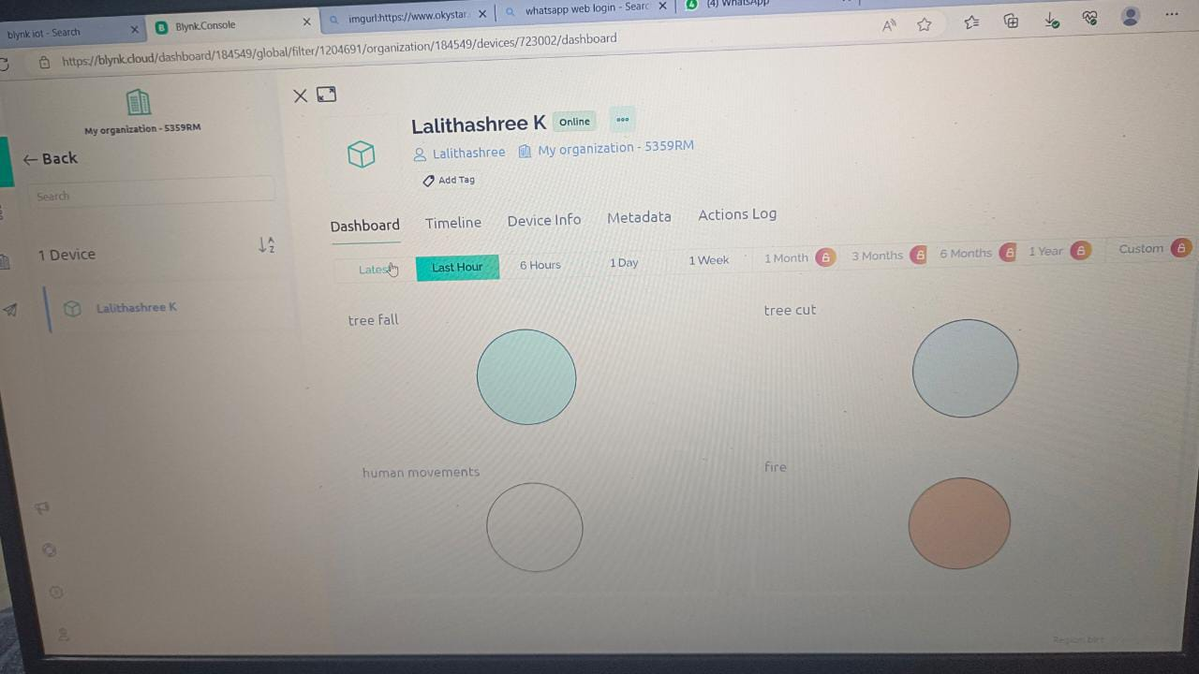
Results

Slide 22
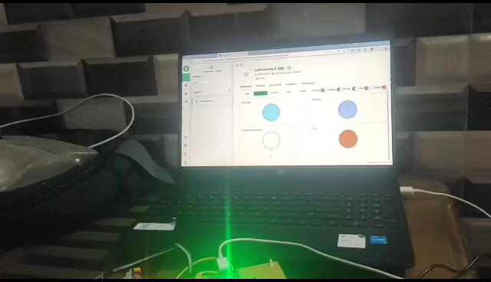
Results

Slide 23
Conclusion
The idea was eliminated to avoid managing important trees in a protected area in the jungle. There are many ways to protect the trees however a light procedure for inserting a few sensors around the trees with a microcontroller has been done.
We are developing such a framework that can be used to prevent deforestation that will thus halt deforestation and maintain environmental balance that will understand one of the problems with global warming that is most commonly used in back forests

Slide 24
Future Scope
Although it is claimed that a Smart module is being developed to protect trees, future improvements are needed to make the system more complex. The Unit / Hardware / Sensors should be hard. The fenced area should be made. – The module should be located in an inaccessible area of trees, not easily accessible to tree destroyers. – Forest officials must be properly trained.

Slide 25
References
Rajesh Singh a , Anita Gehlot , Shaik Vaseem Akram , Amit Kumar Thakur , Dharam Buddhi , Prabin Kumar Das , Forest 4.0: Digitalization of forest using the Internet of Things (IoT) Journal of King Saud University[ELSEVIER] – Computer and Information Sciences- 2022 www.sciencedirect.com.
Mr.V.Narasimman Asst. Prof, Anand.M, Anandha kumar.C, Krishnan.T “Design of a WSN node for forest trees against poaching”, 978-93-87793-11-8, ICAETS-2018.
Santhosh Hebbar, Praveenraj Pattar, Rajeshwari Madli, Varaprasad Golla, “Sandalwood Tree Protection Using Bluetooth Version 4.0”, Conference on Computing and Network Communications, 978-1-4673-7309- 8/15/$31.00 ©2015 IEEE.
Prof. Mhaske D.A. , Bhabad Vishnu S. , PathareSagar A. “Anti-smuggling System for Trees in Forest using Flex Sensor with GSM & Zigbee Network”, International Journal of Advanced Research in Computer and Communication. Engineering Vol. 5, Issue 4, April 2016.
Mohan Sai.S, Naresh K, RajKumar.S, Mohan Sai Ganesh, LokSai, Abhinav “An Infrared Image detecting System model to monitor human with weapon for controlling smuggling of Sandalwood Trees”, International Conference on Inventive Communication and Computational Technologies.
Prof. P. G. Salunkhe, Poonam U. Chaudhari “Design of WSN Node For Protection Of Forest Trees Against Poaching Based MSP430”, International Conference On Advances in Communication and Computing Technology (ICACCT),978-1-5386-0926- 2/18/$31.00
©2018 IEEE

Slide 26
THANK YOU

